Slide 1
August 7, 2022
to
Eldridge United Methodist Church

Slide 2
Serving Today
Hosts: Kelly C & Norma N
Pianist: Kathy Dawson
Liturgist: Keith Riewerts
Screens: CJ Albertson
Treats: Cindy H & Joyce O

Slide 3
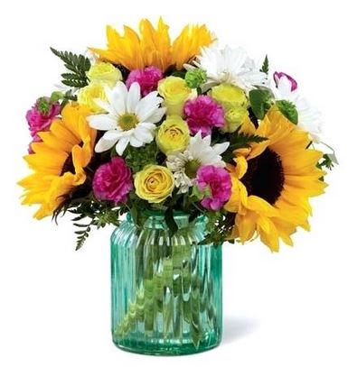
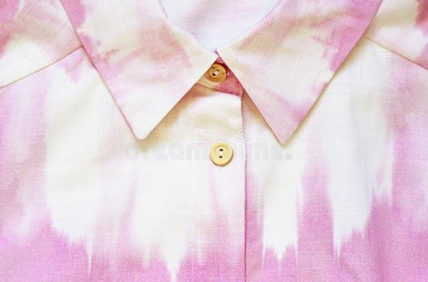
ALTAR
FLOWERS
Today’s
are courtesy of
the Doonans

Slide 4
AUGUST 14th Crew
AUGUST 14th Crew
Hosts: Schoonovers
Pianist: Cindy Irwin
Liturgist: CJ Albertson
Screens: Trish Reisener
Treats: Kathy D & Marianne D

Slide 5
New to EUMC?
Get to know your new friends.
Ask for a
FREE directory.

Slide 6
U.M.W. Resumes soon!
U.M.W.
Next Meeting:
August 24 @ 3pm

Slide 7
AUGUST at the
43 rd annual
Ingathering
FOOD PANTRY
See samples & instructions on the Gathering Area table.
Carrots
Peas
Jelly

Slide 8
Our are with the Ukrainian people.

Slide 9
AUGUST at the
FOOD PANTRY
Pasta, Jelly &
Peanut butter

Slide 10
“The MISSION of the
Eldridge United Methodist Church
is to be a community of loving disciples who proclaim and live love of God and neighbor.”

Slide 11
What’s Happenin’
THIS WEEK
Tue 9-12 “The Club” in ParkView
Wed 1pm Worship Comm. Mtg.
Thu 6:30 Admin Council Mtg.
Sat 7am Men’s Breakfast in Argo

Slide 12
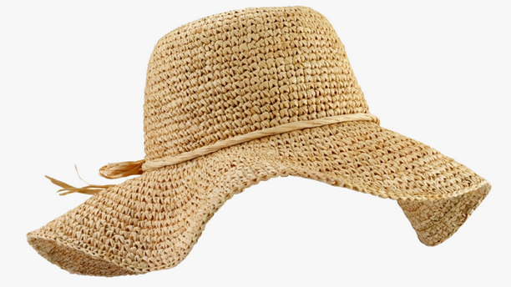
On
vacation?
www.eldridgeumc.org

