Slide 1
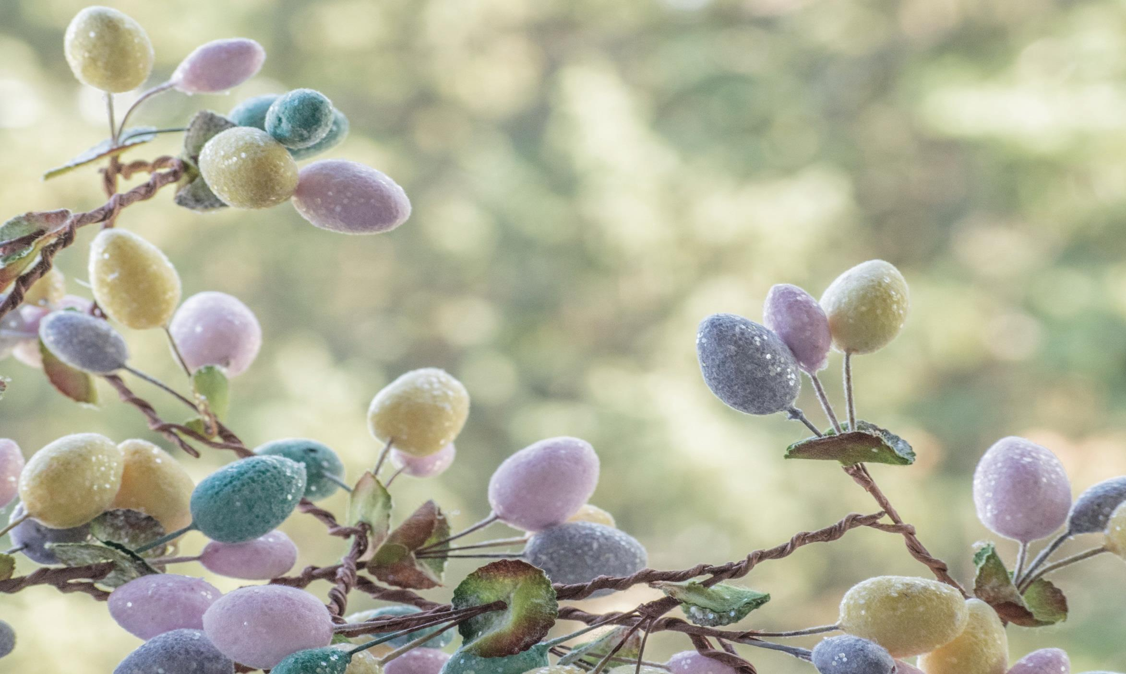
Welcome
to Eldridge United
to Eldridge United
Methodist Church
Methodist Church

Slide 2
SERVING TODAY
Hosts: David & Stacy Muhs
Liturgist: Linda Tubbs
Pianist: Cindy Irwin
Treats: Karen A & Kate B
TVs: CJ Albertson

Slide 3
Today’s Hymns
Today’s Hymns
^{#2158} ^{#2146}
&
(all 3 verses)
(verse 1 only)

Slide 4
This Week’s EVENTS
Mon – Admin mtg re:CAT / 6:30pm
Tue – Bible Study / 10am
Wed – UMW mtg / 3pm
Thu – Newsletter deadline
Sat – Trivia @ McUMC / 6pm

Slide 5
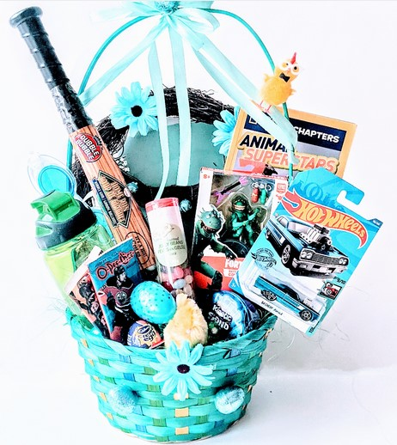
Easter Baskets!
Silent
Auction
next two
Sundays

Slide 6
ALTAR
FLOWERS
compliments of
For:
You
CJ Albertson

Slide 7
Next Week is
Palm
Sunday

Slide 8
NEXT WEEK’s CREW
NEXT WEEK’s CREW
Hosts: Betty Frazee & Joyce Orcutt
Liturgist: Marianne D
Pianist: Kathy Dawson
Treats: Sue C & Judy K
TVs: CJ Albertson

Slide 9
Not feeling well? Out of town?
No matter the reason, we miss you when you aren’t in church.
However, you don’t need to miss church . . .
Sunday Worship is always recorded and available
in its entirety on our
Website or FaceBook page
by Monday morning.

Slide 10
Have you turned in
your
TIME & TALENT SURVEYS
TIME & TALENT SURVEYS

Slide 11
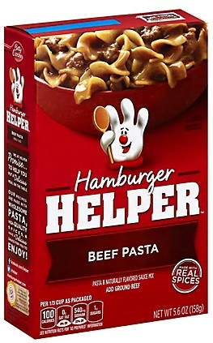
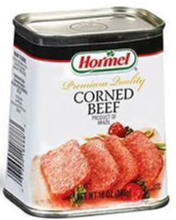
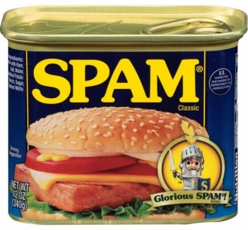
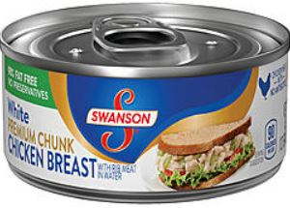
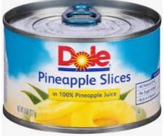
APRIL at the
FOOD PANTRY
Hamburger Helper
Canned Meat & Fruit

Slide 12
EUMC Annual
RUMMAGE SALE
Apr 27-29
featuring UMW
BAKE SALE
8-5 on 28th

Slide 13
We Continue to
Earthquake Victims

Slide 14
“The MISSION of the
Eldridge United Methodist Church
is to be a community of loving disciples who proclaim and live love of God and neighbor.”

Slide 15
Don’t forget the
Ukrainian
Refugees
Ukrainian
Refugees
Keep them in your prayers

Slide 16
www.eldridgeumc.org

