Slide 1
WELCOME
WELCOME
to WORSHIP at
Eldridge United Methodist Church

Slide 2
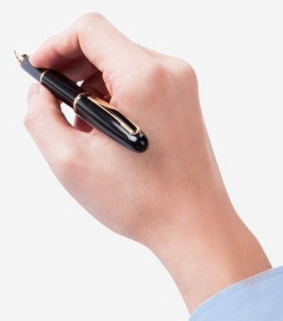
Hello Visitors!
Help us to get to know
you by putting ALL
your contact info on
the attendance sheet.

Slide 3
SERVING TODAY
Liturgist: Trish Reisener
Organist: Tom Luther
TV Screens: Cj Albertson
Hosts: Bea & Gary Abbas
Treats: Kathy D & Betty F

Slide 4
Adult Sunday School
Today’s Topic:
“100 Prophecies Fulfilled”

Slide 5
Today’s
ALTAR FLOWERS
are courtesy of
Mike & Jan
Wright

Slide 6
It’s (way past) Time for a New
MEMBERSHIP DIRECTORY
MEMBERSHIP DIRECTORY
Photo sessions here – May 2 & 3
Sign Up on-line or in G.A. TODAY
Free session – tell friends/family
Free 8X10, Free Directory and…
Free APP!!
Chair: Karen Apple

Slide 7
CHURCH WORK DAY
B-i-g
THANKS
to all who helped!!!

Slide 8
This Week . . .
TODAY – begin bringing donations for
the Rummage Sale (thru Wed)
WED – United Women of Faith@3pm
THU-SAT – RUMMAGE SALE!!!

Slide 9
CREW for Apr. 28th
CREW for Apr. 28th
Hosts: Ben & Karen Apple
Pianist: Linda Reickard
Liturgist: Lynn Reth
TV Screens: Cj Albertson
Treats: Kelly C & Marianne D

Slide 10
“The MISSION of the
Eldridge United Methodist Church
is to be a community of loving disciples who proclaim and live love of God and neighbor.”

Slide 11
EUMC Annual
RUMMAGE SALE
Apr 25-27
featuring UMW
BAKE SALE
8-5 Thu & Fri

Slide 12
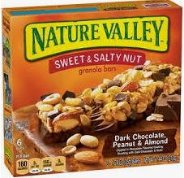
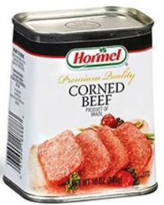
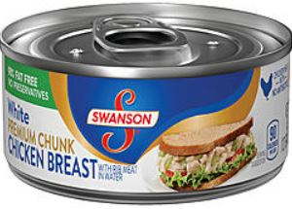
APRIL at the
FOOD PANTRY
Canned Meat &
Granola / Cereal Bars

Slide 13
ALTAR FLOWERS
ALTAR FLOWERS
Sign-Up Sheets
on the
Gathering Area Window

Slide 14
Not feeling well? Out of town?
No matter the reason, we miss you when you aren’t in church.
However, you don’t need to miss church . . .
Sunday Worship is always recorded and available
in its entirety on our
Website or FaceBook page
by Monday morning.

Slide 15
Gotta Grad?
Please notify the church office by
May 1

Slide 16
www.eldridgeumc.org

