Slide 1
WELCOME
WELCOME
to WORSHIP at
Eldridge United Methodist Church

Slide 2
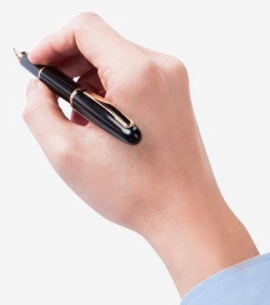
Hello Visitors!
Help us to get to know
you by putting ALL
your contact info on
the attendance sheet.

Slide 3
SERVING TODAY
Liturgist: Lynn Reth
Pianist: Linda Reickard
TV Screens: Cj Albertson
Hosts: Ben & Karen Apple
Treats: Kelly C & Marianne D

Slide 4
Adult Sunday School
Today’s Topic:
“Parables of Jesus”

Slide 5
Today’s
ALTAR FLOWERS
are courtesy of
Betty & Larry
Frazee

Slide 6
It’s almost (...but not quite!) too late
to have your photo taken
for the
Sign Up Online (see your bulletin for instructions)
Questions? See Karen in the Gathering Area after church
May
2 & 3

Slide 7
“The MISSION of the
Eldridge United Methodist Church
is to be a community of loving disciples who proclaim and live love of God and neighbor.”

Slide 8
EUMC Annual
RUMMAGE SALE
was a HUGE
success!
Thank You!

Slide 9
CREW for May 5th
CREW for May 5th
Hosts: Nancy B & ?????
Pianist: Kathy Dawson
Liturgist: Keith Riewerts
TV Screens: Cj Albertson
Treats: Janalee K & Linda R

Slide 10
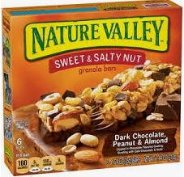
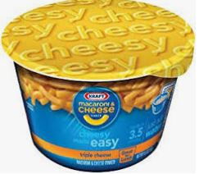
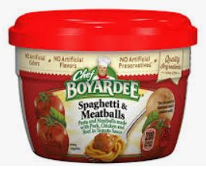
MAY at the
FOOD PANTRY
Kid-Friendly
Foods for Summer

Slide 11
Gotta Grad?
Please notify the church office by
May 1

Slide 12
Not feeling well? Out of town?
No matter the reason, we miss you when you aren’t in church.
However, you don’t need to miss church . . .
Sunday Worship is always recorded and available
in its entirety on our
Website or FaceBook page
by Monday morning.

Slide 13
www.eldridgeumc.org

