Slide 1
April 14, 2024

Slide 2
Kathy Dawson, pianist
“On Holy Ground”
PRELUDE
PRELUDE

Slide 3
(read responsively)
Call to
Worship

Slide 4
LITURGIST:
Sing praises to God,
O faithful ones.

Slide 5
PEOPLE:
Give thanks and proclaim God’s holy name.

Slide 6
LITURGIST:
Weeping or joyful;
mourning or dancing.

Slide 7
PEOPLE:
Come as you are, for all are welcome here.

Slide 8
LITURGIST:
Open your hearts
to healing,
to life restored.

Slide 9
PEOPLE:
Let us worship God.

Slide 10
HYMN #140
“Great Is Thy Faithfulness”

Slide 11
Great is thy faithfulness, O God my father; there is no shadow of turning with thee; Thou changest not, thy compassions, they fail not; as thou has been, thou for ever wilt be.
Verse 1:

Slide 12
Great is thy faithfulness! Great is thy faithfulness! Morning by morning new mercies I see;
Refrain:

Slide 13
All I have needed thy hand hath provided; great is thy faithfulness, Lord, unto me!

Slide 14
Summer & winter & springtime & harvest, sun, moon, & stars in their courses above join with all nature in manifold witness to thy great faithfulness, mercy & love.
Verse 2:

Slide 15
Great is thy faithfulness! Great is thy faithfulness! Morning by morning new mercies I see;
Refrain:

Slide 16
All I have needed thy hand hath provided; great is thy faithfulness, Lord, unto me!

Slide 17
Pardon for sin & a peace that endureth, thine own dear presence to cheer& to guide; Strength for today and bright hope for tomorrow, blessings all mine, with 10,000 beside!
Verse 3:

Slide 18
Great is thy faithfulness! Great is thy faithfulness! Morning by morning new mercies I see;
Refrain:

Slide 19
All I have needed thy hand hath provided; great is thy faithfulness, Lord, unto me!

Slide 20
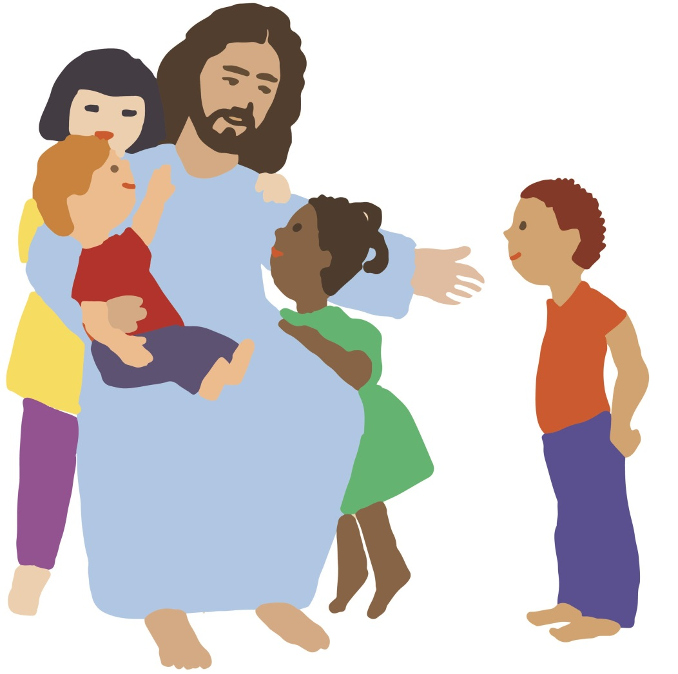
CHILDREN’S
Blessing
&
Dismissal

Slide 21
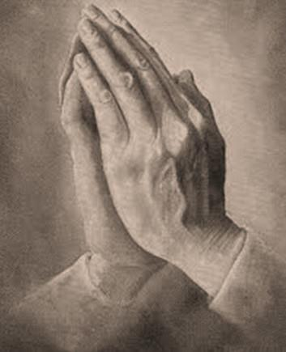
Opening
Prayer

Slide 22
Scripture Reading
Psalm 84: 12

Slide 23
O Lord of hosts,
happy is everyone
who TRUSTS in you.

Slide 24
L: This is the word of God
for the people of God.
P: Thanks be to God.

Slide 25
The Worst
& Best word:
‘Trust’

Slide 26
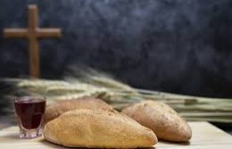
The Sacrament of
Holy
Communion

Slide 27
Prayer of
Confession

Slide 28
(All)
Merciful God,
We confess that we have not loved you
with our whole heart.

Slide 29
We have failed to be
an obedient church.
We have not done your
will, we have broken
your law . . .

Slide 30
. . .we have rebelled against your love, we have not loved our neighbors . . .

Slide 31
. . . and we have not
heard the cry of
the needy.
Forgive us, we pray.

Slide 32
Free us for
joyful obedience,
through Jesus Christ
our Lord.
Amen

Slide 33
Pardon

Slide 34
(Pastor)
Hear the good news:
Christ died for us while
we were yet sinners;

Slide 35
That proves God’s love
toward us.
In the name of
Jesus Christ,
you are forgiven!

Slide 36
(People)
In the name of
Jesus Christ,
you are forgiven!

Slide 37
Glory to God.
Amen

Slide 38
The Great
Thanksgiving

Slide 39
(Pastor)
The Lord be with you.
(People)
And also with you.

Slide 40
(Pastor)
Lift up your hearts.
(People)
We lift them up to
the Lord.

Slide 41
(Pastor) Let us give thanks
to the Lord our God.
(People) It is right to give
our thanks & praise.

Slide 42
(Pastor)
It is right, and a
good & joyful thing,
always & everywhere…

Slide 43
…to give thanks to you,
Father Almighty,
creator of heaven
& earth.

Slide 44
And so, with your
people on earth and all
the company of heaven,
we praise your name &
join the unending hymn:

Slide 45
(People)
Holy, holy, holy Lord,
God of power & might, heaven & earth are
full of your glory.

Slide 46
Hosanna in the highest.
Blessed is he who comes in the name of the Lord.
Hosanna in the highest.

Slide 47
(Pastor)
Holy are you and
blessed is your Son,
Jesus Christ.

Slide 48
By the baptism
of his suffering, death,
and resurrection,

Slide 49
you gave birth to
your church,
delivered us from
slavery to sin and death,

Slide 50
and made with us
a new covenant
by water
and the Spirit.

Slide 51
(Hymnals closed – Looking at Pastor)
The
Institution

Slide 52
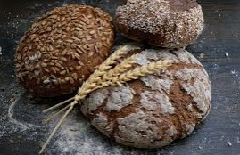
the
BODY of
CHRIST
given for
you

Slide 53
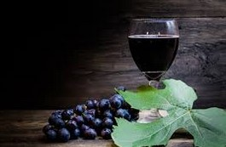
the
BLOOD of CHRIST
given for you

Slide 54
…as we proclaim
the mystery of faith.
(Pastor continues…)

Slide 55
(All)
Christ has died.
Christ is risen.
Christ will come again.

Slide 56
. . . through your son
Jesus Christ,
with the Holy Spirit
in your holy Church,
(Pastor continues…)

Slide 57
all honor and glory
is yours,
almighty God,
now and forever.

Slide 58
Amen

Slide 59
The Bread
& The Cup

Slide 60
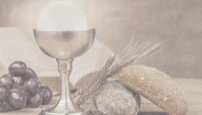
Come.
Receive the bread. “Amen”
Drink of the cup. “Amen”
Remember.

Slide 62
Unison Prayer
Eternal God,
we give you thanks for
this holy mystery
in which you have given
yourself to us.

Slide 63
Grant that we may
go into the world
in the strength
of your Spirit,
to give ourselves for others.

Slide 64
In the name of
Jesus Christ
our Lord.
AMEN

Slide 65
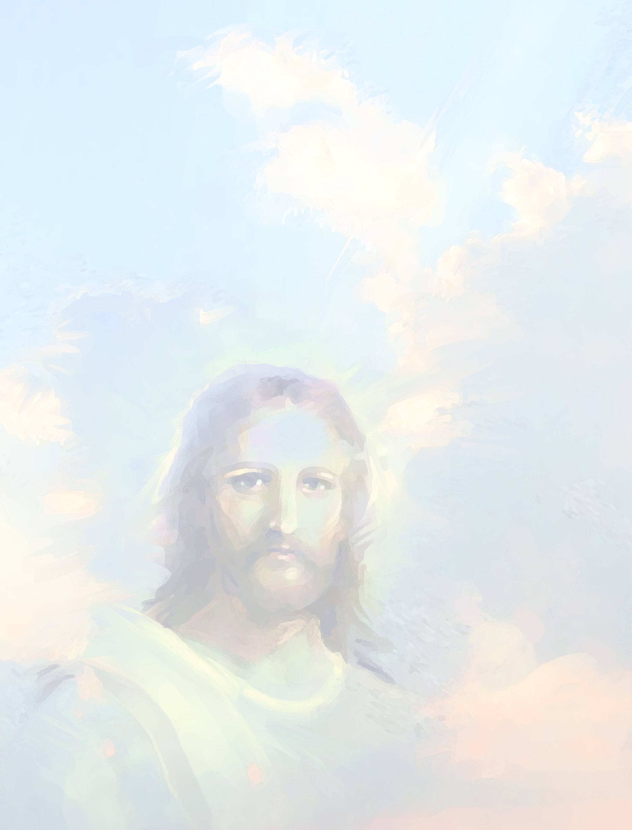

Slide 66
As the piano plays,
TITHES & OFFERINGS may be placed in the plates at either the front or
back of the sanctuary.
Thank you!

Slide 67
Offertory
“’Neath the Heart of God”

Slide 68
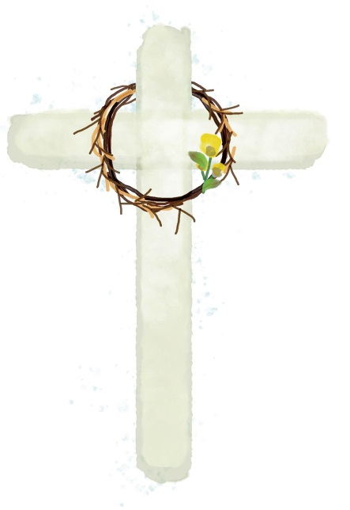
Please Stand
the
Doxology

Slide 69
Praise God,
from whom
all blessings flow;

Slide 70
Praise God,
all creatures here below.

Slide 71
Alleluia!
Alleluia!

Slide 72
Praise God,
the source of
all our gifts!

Slide 73
Praise Jesus Christ
whose power
uplifts!

Slide 74
Praise the Spirit,
Holy Spirit!
Alleluia! Alleluia!

Slide 75
Alleluia!

Slide 76
SHARING JOYS
& CONCERNS
Pastoral Prayer

Slide 77
in unison:
Our Father,
who art in heaven,
hallowed be thy name.

Slide 78
Thy kingdom come,
thy will be done
on earth
as it is in heaven.

Slide 79
Give us this day
our daily bread

Slide 80
and forgive us our trespasses,
as we forgive those who trespass against us.

Slide 81
And lead us
not into temptation,
but deliver us
from evil.

Slide 82
For thine is the KINGDOM,
and the POWER,
and the GLORY forever.
Amen.

Slide 83
HYMN #700
(verse 3 only)
“ABIDE WITH ME”

Slide 84
I need Thy presence every passing hour.
What but thy grace can foil the tempter’s power
Who, like thyself, my guide and stay can be
Through cloud and sunshine,
Lord, abide with me.

Slide 85
Special
Announcement

Slide 86
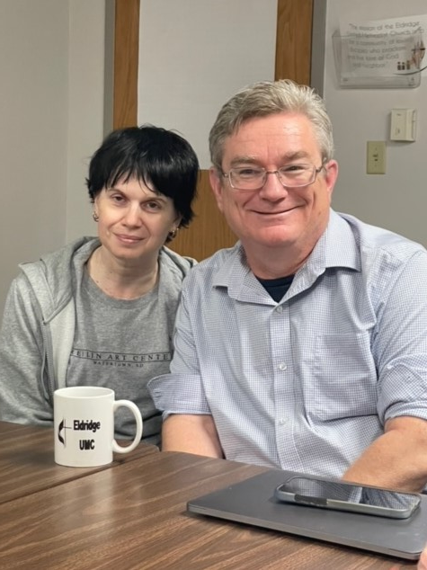
“Pastor Jim”
&
Rebekkah
Shrimplin

Slide 87
Blessing
& Dismissal

Slide 88
Kathy Dawson, pianist
“Praise Him, Praise Him”
POSTLUDE
POSTLUDE

