Slide 1
April 21, 2024

Slide 2
Tom Luther, organist
“Above All”
PRELUDE
PRELUDE

Slide 3
(read responsively)
Call to
Worship

Slide 4
LITURGIST:
As the rains pour from heaven, soaking the earth that it may produce good things –

Slide 5
PEOPLE:
– so God pours love upon us, so that we, too, may produce goodness and peace.

Slide 6
LITURGIST:
We come joyfully to
the house of the Lord.

Slide 7
PEOPLE:
We bring our praise &
offer our lives to God.

Slide 8
LITURGIST:
This is our gift and our
sacrifice – an act of
devotion to God.

Slide 9
PEOPLE:
Let us worship and
celebrate the mighty
love & power of God.

Slide 10
LITURGIST:
Praise be to God who
has blessed us in so
many ways.

Slide 11
PEOPLE:
Thanks be to God who
calls us His children &
pours out abundant
blessings upon us. Amen

Slide 12
CHOIR ANTHEM
“Soon &
Very Soon”

Slide 13
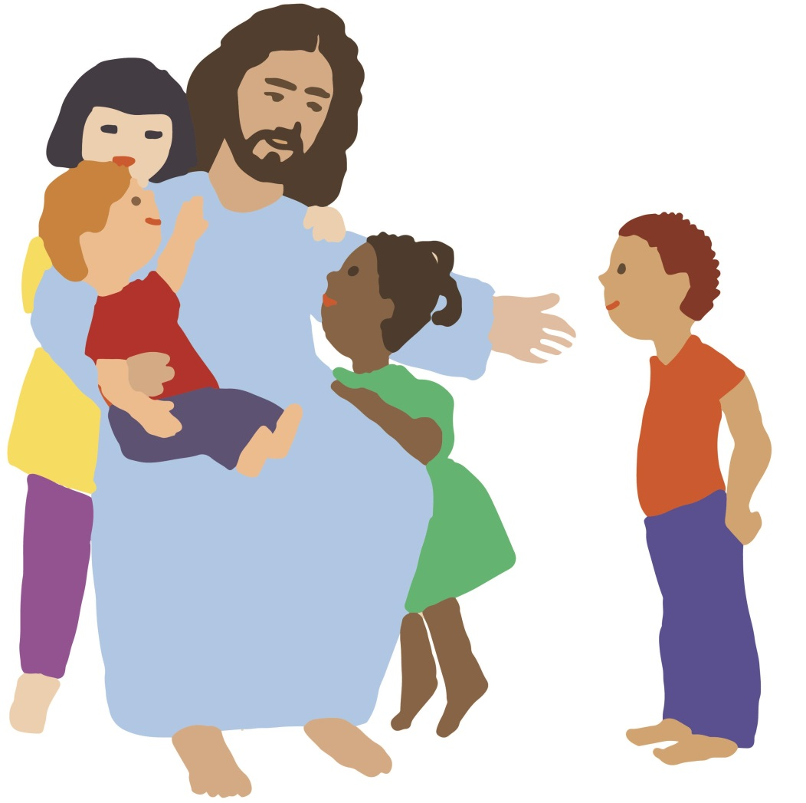
CHILDREN’S
Blessing
&
Dismissal

Slide 14
HYMN #539
“O Spirit of
the Living God”
Vs. 1 & 4

Slide 15
O Spirit of the living God, thou light and fire divine, descend upon thy church once more, and make it truly thine.
Verse 1:

Slide 16
Fill it with love and joy and power, with righteousness and peace; till Christ shall dwell in human hearts, and sin and sorrow cease.

Slide 17
So shall we know the power of Christ who came this world to save; so shall we rise with Him to life which soars beyond the grave;
Verse 4:

Slide 18
And earth shall win true holiness, which makes thy children whole; till, per-fec-ted by thee, we reach creation’s glorious goal!

Slide 19
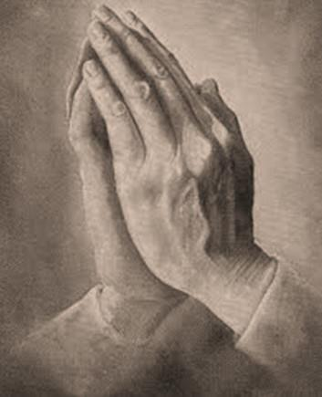
Opening
Prayer

Slide 20
Scripture Readings
Numbers 13:25-33 & 14:24

Slide 21
At the end of forty days they returned from spying out the land & they came to Moses & Aaron & to all the congregation of the Israelites in the wilderness of Paran, at Kadesh;

Slide 22
they brought back word to them and to all the congregation,
and showed them
the fruit of the land.
And they told him, . . .

Slide 23
‘We came to the land to which you sent us; it flows with milk and honey, and this is its fruit. Yet the people who live in the land are strong, and the towns are fortified and very large;

Slide 24
and besides, we saw the descendants of Anak there.
The Amalekites live in
the land of the Negeb;

Slide 25
the Hittites, the Jebusites, and the Amorites
live in the hill country;
and the Canaanites live by the sea, and along the Jordan.’

Slide 26
But Caleb quieted the people before Moses, and said,
‘Let us go up at once
and occupy it,
for we are well able to overcome it.’

Slide 27
Then the men who had gone up with him said,
‘We are not able to go up
against this people,
for they are stronger
than we are.’

Slide 28
So they brought to the Israelites
an unfavourable report of the
land that they had spied out,
saying, . . .

Slide 29
‘The land that we have gone through as spies is a land that devours its inhabitants;
and all the people that we saw in it are of great size.

Slide 30
There we saw the Nephilim (the Anakites come from the Nephilim);
and to ourselves we seemed like grasshoppers, and so we seemed to them.’

Slide 31
But my servant Caleb, because he has a different spirit and has followed me wholeheartedly,
I will bring into the land into which he went, & his descendants shall possess it.

Slide 32
L: This is the word of God
for the people of God.
P: Thanks be to God.

Slide 33
The BLESSING
of
Wholehearted
FAITH

Slide 34
As the piano plays,
TITHES & OFFERINGS may be placed in the plates at either the front or
back of the sanctuary.
Thank you!

Slide 35
Offertory
“Here I Am, Lord”

Slide 36
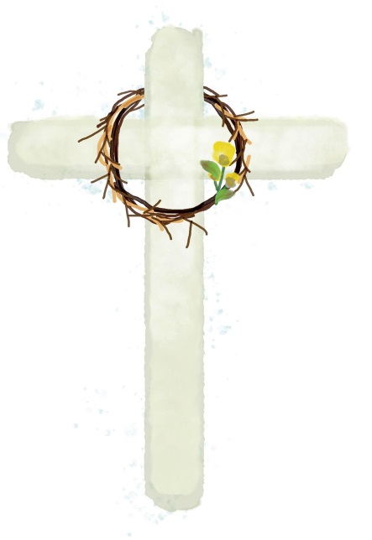
Please Stand
the
Doxology

Slide 37
Praise God,
from whom
all blessings flow;

Slide 38
Praise God,
all creatures here below.

Slide 39
Alleluia!
Alleluia!

Slide 40
Praise God,
the source of
all our gifts!

Slide 41
Praise Jesus Christ
whose power
uplifts!

Slide 42
Praise the Spirit,
Holy Spirit!
Alleluia! Alleluia!

Slide 43
Alleluia!

Slide 44
SHARING JOYS
& CONCERNS
Pastoral Prayer

Slide 45
in unison:
Our Father,
who art in heaven,
hallowed be thy name.

Slide 46
Thy kingdom come,
thy will be done
on earth
as it is in heaven.

Slide 47
Give us this day
our daily bread

Slide 48
and forgive us our trespasses,
as we forgive those who trespass against us.

Slide 49
And lead us
not into temptation,
but deliver us
from evil.

Slide 50
For thine is the KINGDOM,
and the POWER,
and the GLORY forever.
Amen.

Slide 51
HYMN #133
(verse 3 only)
“everlasting arms”

Slide 52
What have I to dread,
what have I to fear,
leaning on the everlasting arms;
I have blessed peace
with my Lord so near,
leaning on the everlasting arms.

Slide 53
Leaning (…on Jesus),
leaning (…on Jesus),
safe and secure from all alarms;
Leaning (…on Jesus),
leaning (…on Jesus),
leaning on the everlasting arms.

Slide 54
Blessing
& Dismissal

Slide 55
Tom Luther, organist
“On Eagle’s Wings”
POSTLUDE
POSTLUDE

