Slide 1
April 28, 2024

Slide 2
Linda Reickard, pianist
“Hymn of Promise”
PRELUDE
PRELUDE

Slide 3
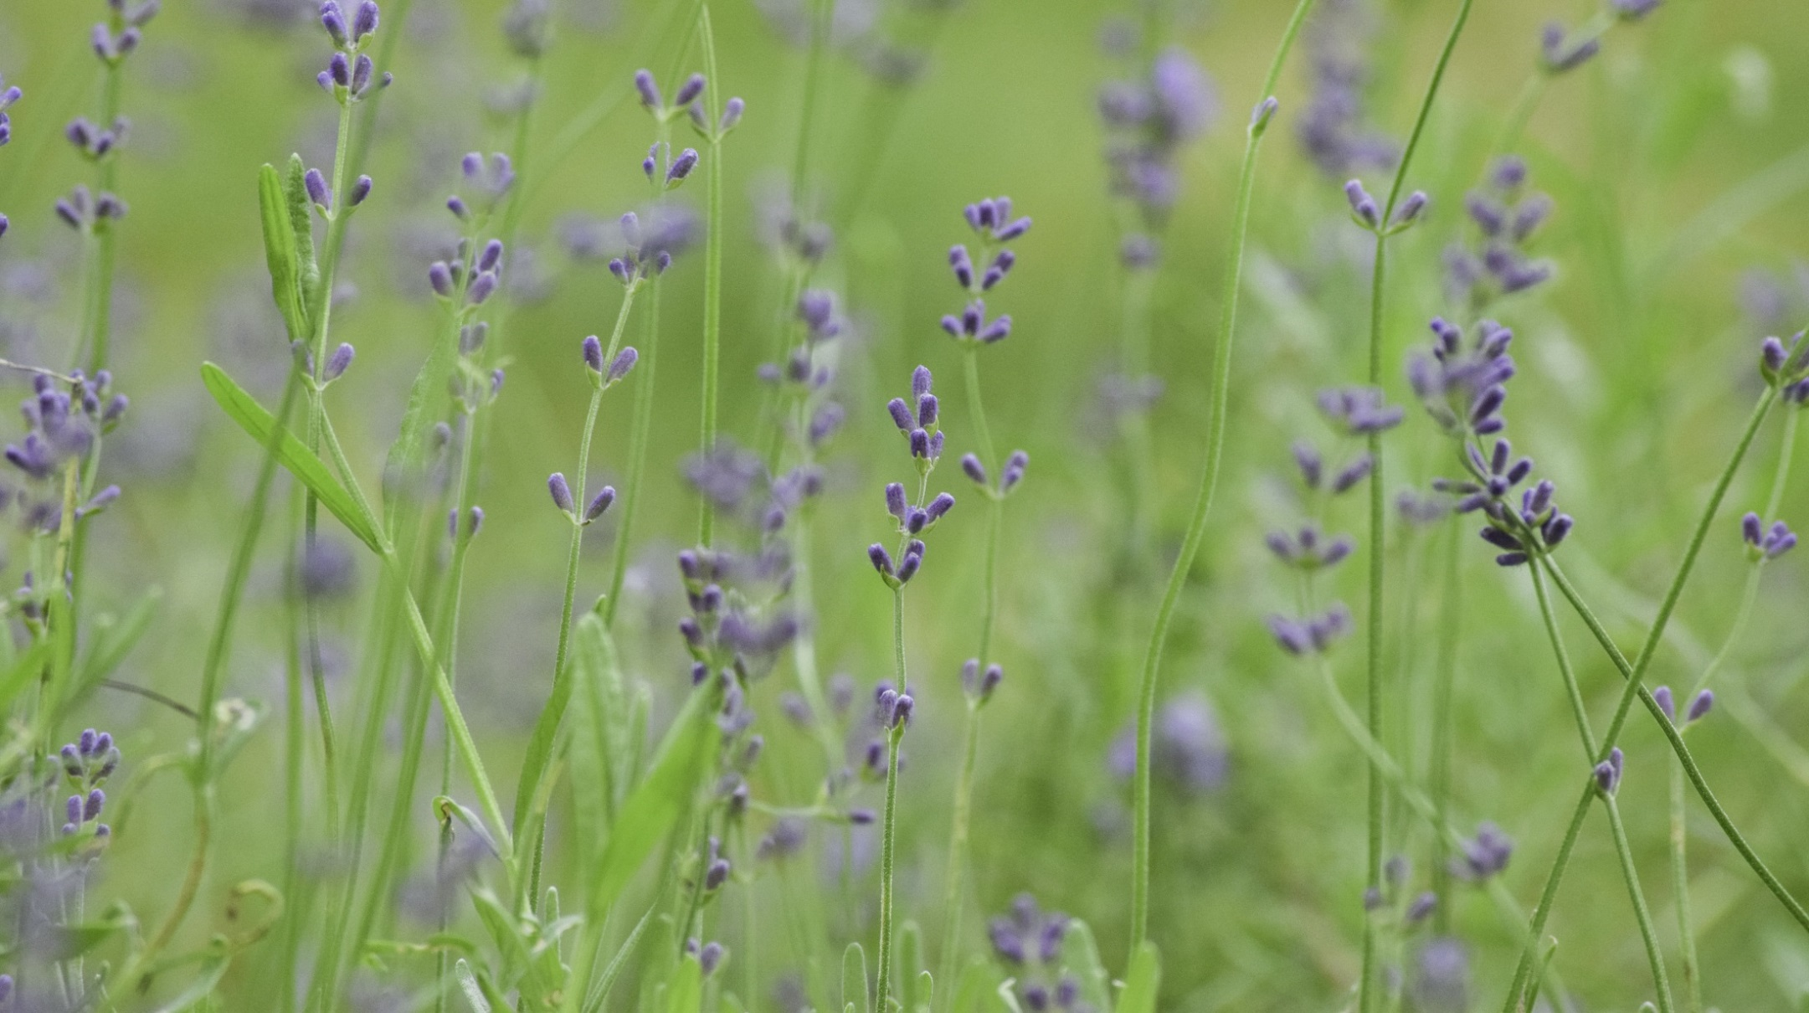
(read responsively)
Call to
Worship

Slide 4
LITURGIST:
Today is a day especially created for you to find peace and rest.

Slide 5
PEOPLE:
In the midst of our hectic lives, we surely need such a time as this.

Slide 6
LITURGIST:
Come.
Rest in the Lord.

Slide 7
PEOPLE:
Our souls long for
God’s refreshing love.

Slide 8
LITURGIST:
Let the demands of your week melt away in God’s presence.

Slide 9
PEOPLE:
Refresh and restore us, O Lord, we pray. Amen.

Slide 10
CHOIR ANTHEM
“Draw Us
together”

Slide 11
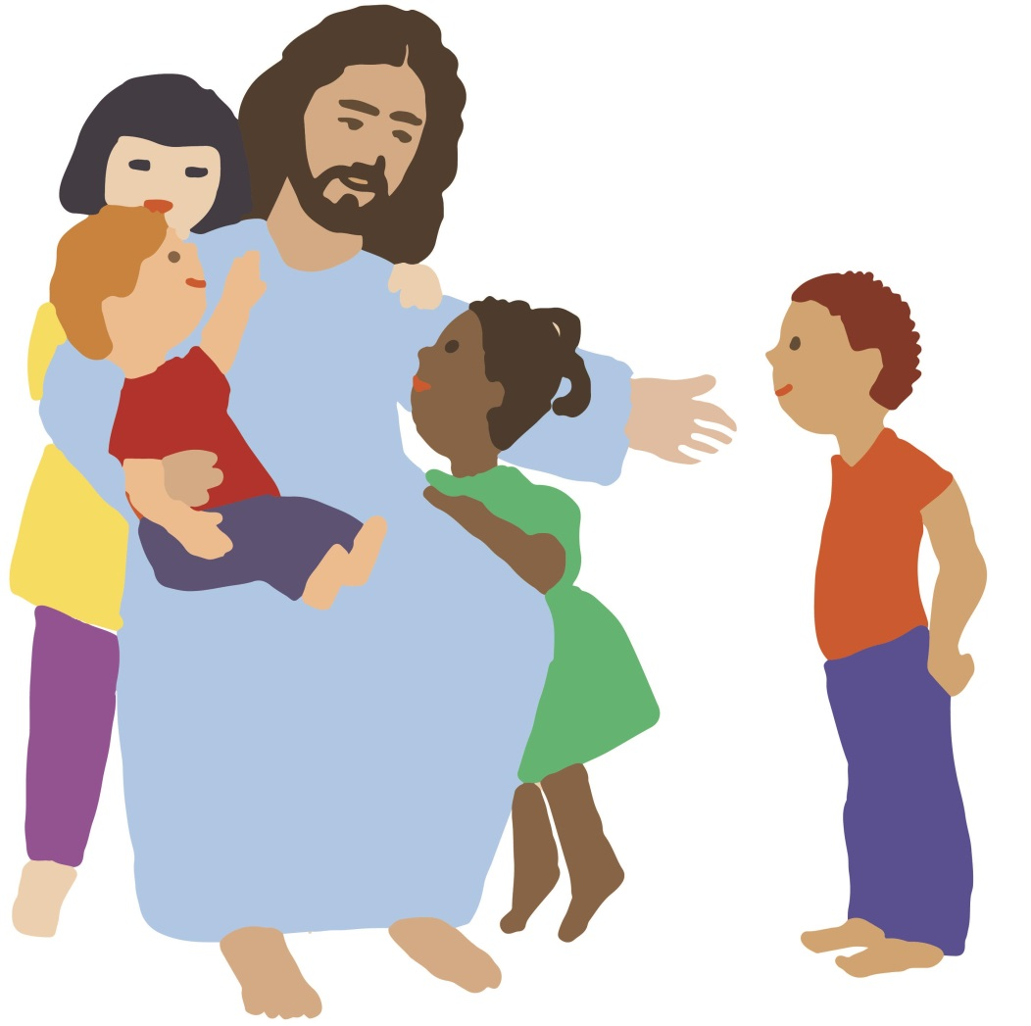
CHILDREN’S
Blessing
&
Dismissal

Slide 12
HYMN #131
“We Gather
Together”

Slide 13
We gather together to ask the Lord’s blessing; he chastens and hastens his will to make known.
Verse 1:

Slide 14
The wicked oppressing now cease from distressing. Sing praises to his name; he forgets not his own.

Slide 15
Beside us to guide us, our God with us joining, ordaining, maintaining his kingdom divine;
Verse 2:

Slide 16
So from the beginning the fight we were winning; thou, Lord, wast at our side, all glory be thine!

Slide 17
We all do extol thee, thou leader triumphant, and pray that thou still our defender wilt be.
Verse 3:

Slide 18
Let thy congregation escape tribulation; thy name be ever praised! O Lord, make us free!

Slide 19
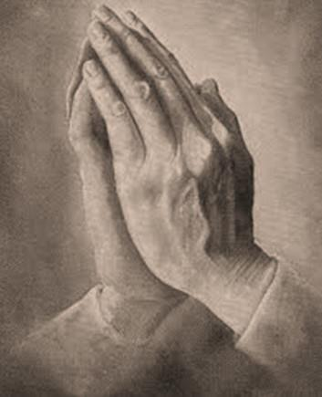
Opening
Prayer

Slide 20
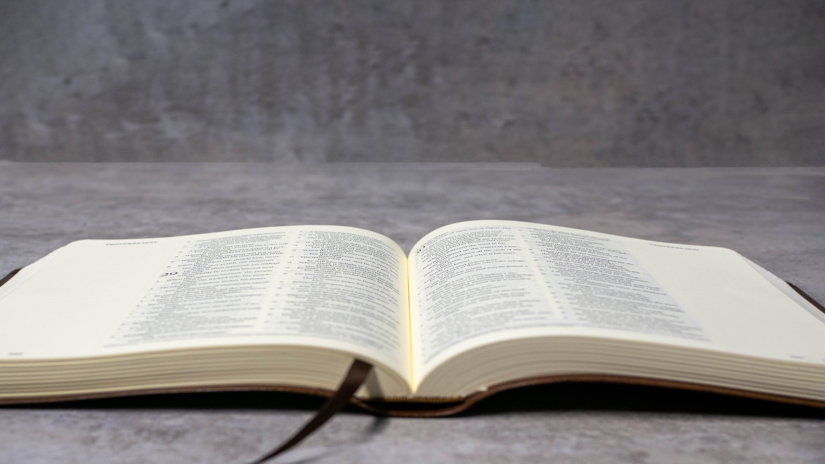
Scripture Readings
Daniel 9:14

Slide 21
So the Lord kept watch over this calamity until he
brought it upon us.
Indeed, the Lord our God is right in all that he has done; for we have disobeyed his voice.

Slide 22
L: This is the word of God
for the people of God.
P: Thanks be to God.

Slide 23
POWERFUL
PRAYER
Victory
for

Slide 24
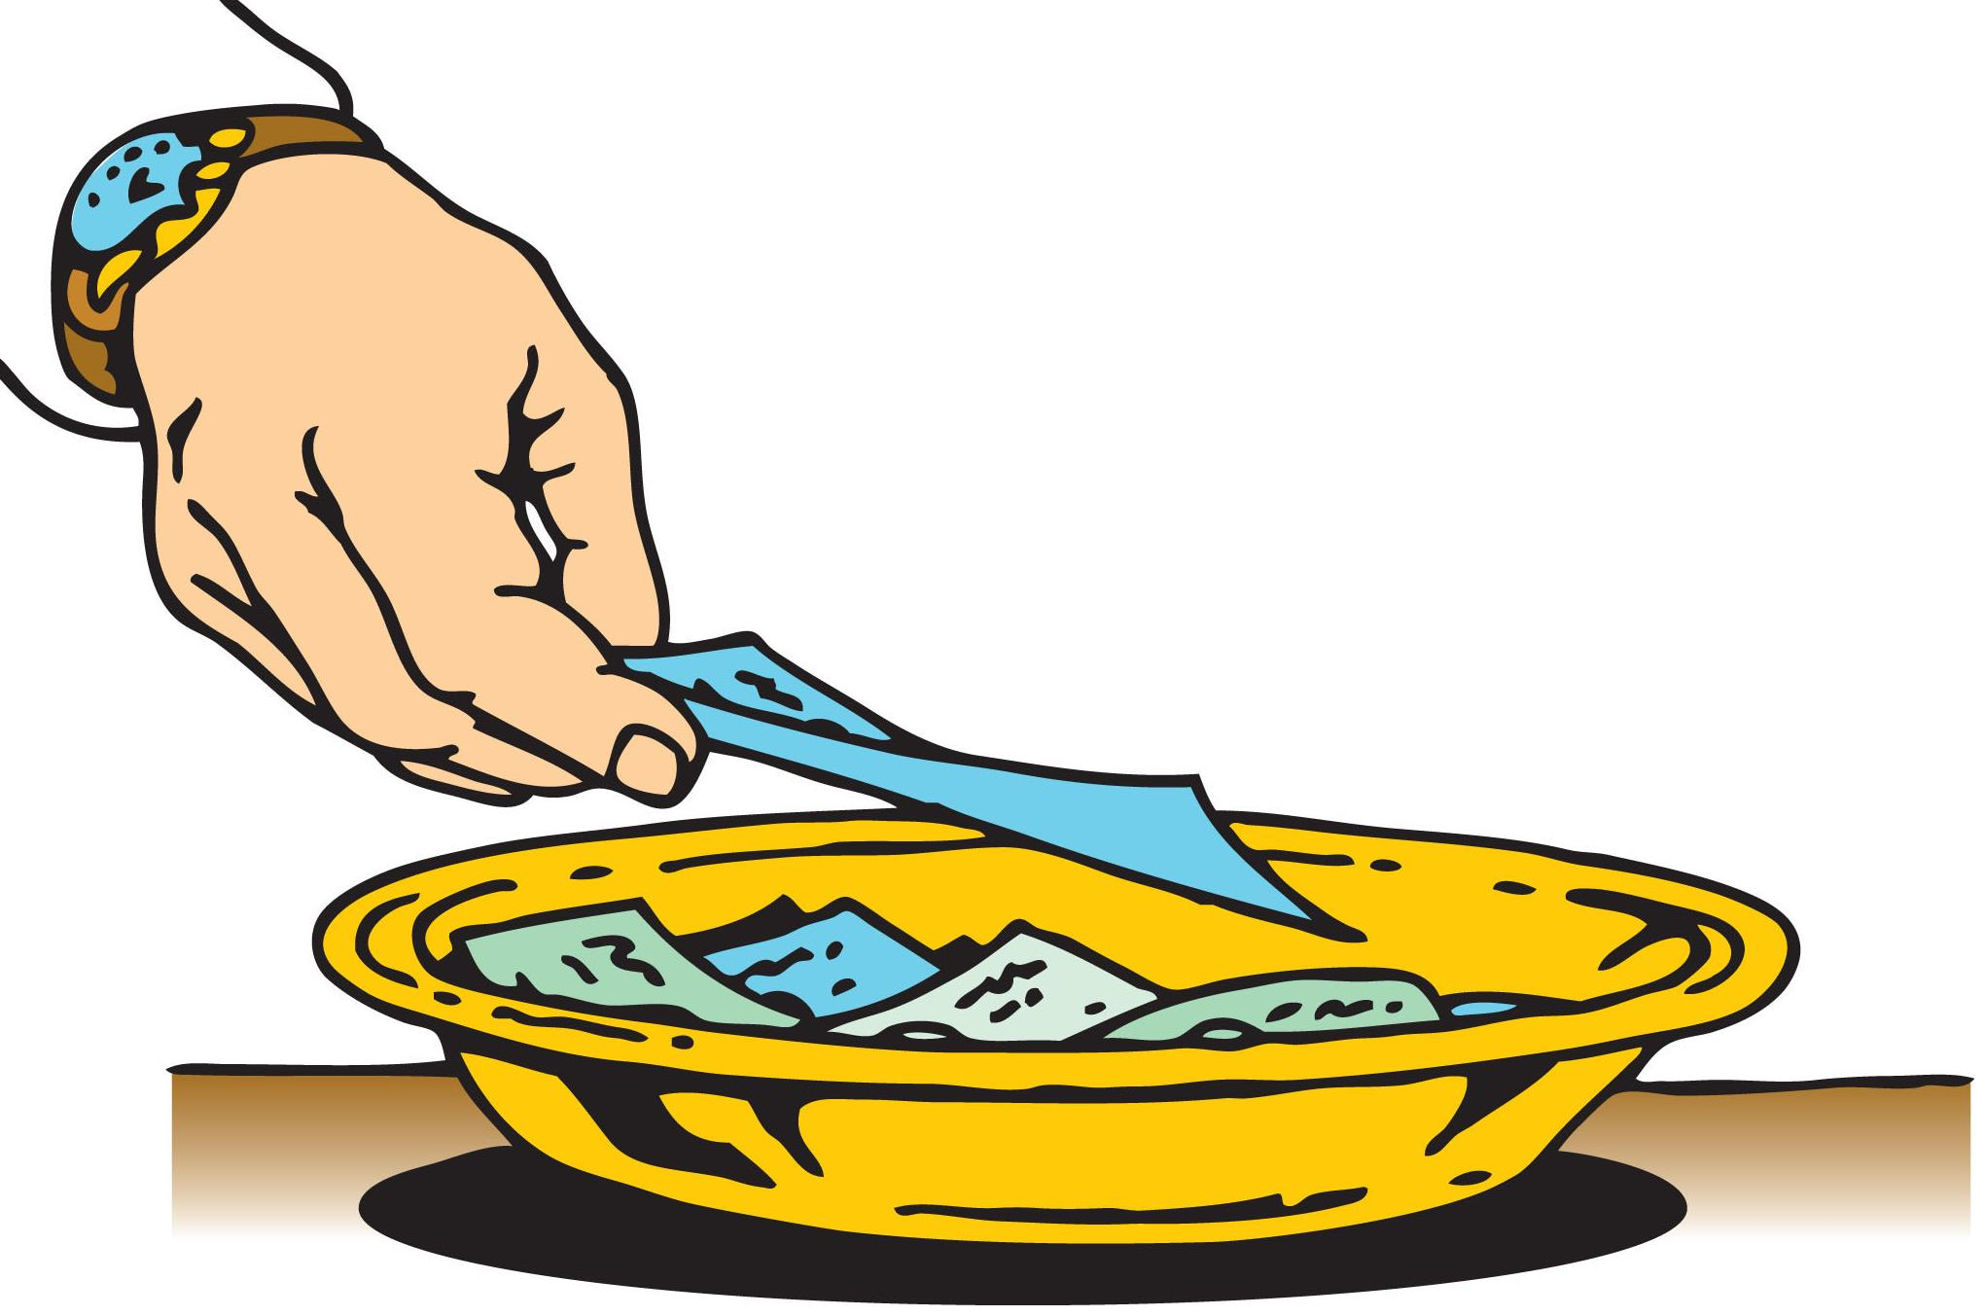
As the piano plays,
TITHES & OFFERINGS may be placed in the plates at either the front or
back of the sanctuary.
Thank you!

Slide 25
Offertory
“Consolation”

Slide 26
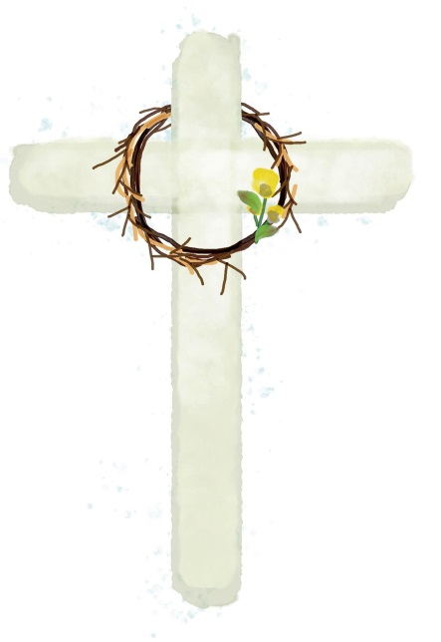
Please Stand
the
Doxology

Slide 27
Praise God,
from whom
all blessings flow;

Slide 28
Praise God,
all creatures here below.

Slide 29
Alleluia!
Alleluia!

Slide 30
Praise God,
the source of
all our gifts!

Slide 31
Praise Jesus Christ
whose power
uplifts!

Slide 32
Praise the Spirit,
Holy Spirit!
Alleluia! Alleluia!

Slide 33
Alleluia!

Slide 34
SHARING JOYS
& CONCERNS
Pastoral Prayer

Slide 35
in unison:
Our Father,
who art in heaven,
hallowed be thy name.

Slide 36
Thy kingdom come,
thy will be done
on earth
as it is in heaven.

Slide 37
Give us this day
our daily bread

Slide 38
and forgive us our trespasses,
as we forgive those who trespass against us.

Slide 39
And lead us
not into temptation,
but deliver us
from evil.

Slide 40
For thine is the KINGDOM,
and the POWER,
and the GLORY forever.
Amen.

Slide 41
HYMN #467
(verses 1 & 2)
“Trust & Obey”

Slide 42
When we walk with the Lord
in the light of his word,
what a glory
he sheds on our way!
V1

Slide 43
While we do his good will,
He abides with us still,
and with all who
will trust & obey.

Slide 44
Trust & Obey,
for there’s no other way
to be happy in Jesus—
but to trust and obey.

Slide 45
Not a burden we bear,
not a sorrow we share,
but our toil
he doth richly repay;
V2

Slide 46
Not a grief or a loss,
not a frown or a cross,
but is blest
if we trust and obey.

Slide 47
Trust & Obey,
for there’s no other way
to be happy in Jesus—
but to trust and obey.

Slide 48
Blessing
& Dismissal

Slide 49
Linda Reickard, pianist
“The Crusaders”
POSTLUDE
POSTLUDE

