Slide 1
Welcome
Welcome
to Eldridge United Methodist Church
to Eldridge United Methodist Church
May 18, 2025 – Organ Dedication!

Slide 2
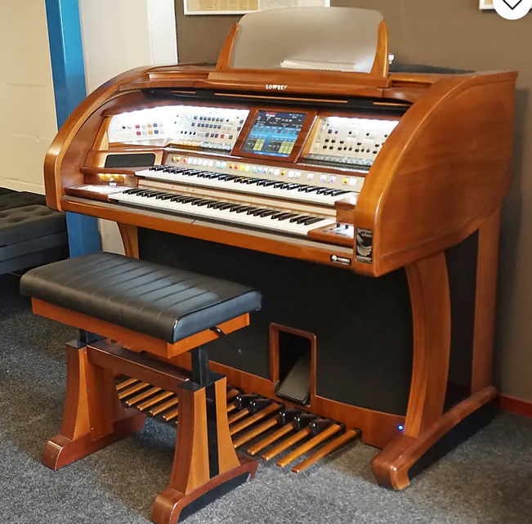
TODAY
TODAY
Special
Organ
Dedication
Worship &
Hymn Sing

Slide 3
SERVING TODAY
Hosts: Karen A & Janalee K
Liturgists: Worship Comm.
Organist: Tom Luther
Pianist: Kathy Dawson
Kitchen: Lori Stackhouse
TV Screens: CJ Albertson

Slide 4
Today’s VIDEO PRELUDE:
“Sing Your Praise
to the Lord”
Written & Performed by RICH MULLINS

Slide 5
Today’s ALTAR FLOWERS are from
Christie Nevenhoven

Slide 6
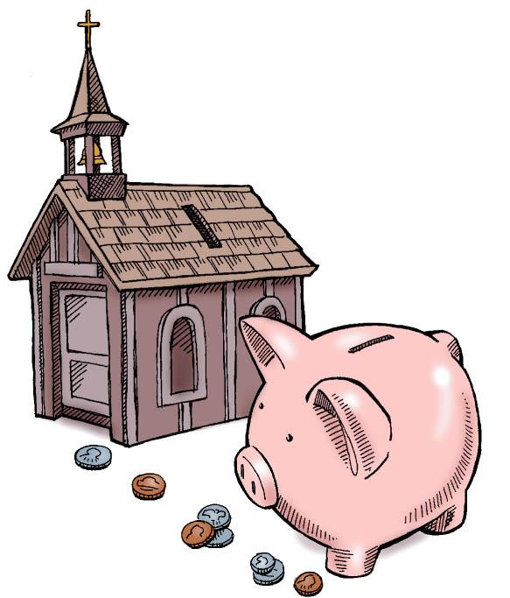
Piggy Banks
& Checks are still be taken thru May 25th for our
Annual Donation to the
Humility of Mary Shelter for Abused Women

Slide 7
Membership Directory is – almost – here!
Please take a couple moments TODAY to check the ‘proofs’ on the
clipboard & OK your info.
As soon as this is done,
we mail it in and get it back for distribution.
Help us ‘gitter dun’!

Slide 8
NEXT WEEK’s CREW
Hosts: Christie N & Doug B
Pianist: Linda Reickard
Liturgist: Charles Wheeler
TV Screens: CJ Albertson
Kitchen Helper: Karen Apple

Slide 9
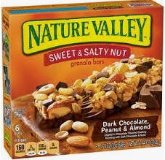
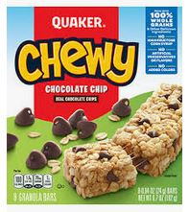
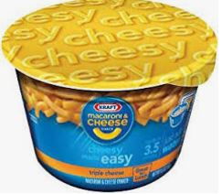
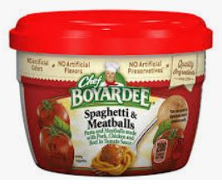
MAY at the
FOOD PANTRY
Kid-Friendly
Foods for Summer

Slide 10
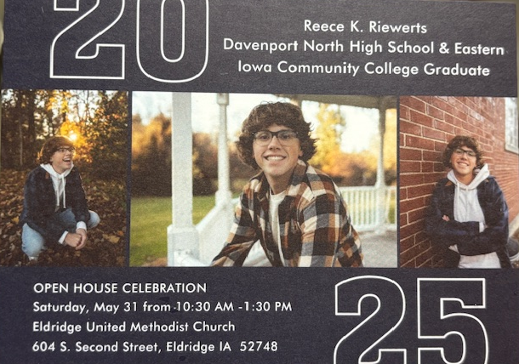
Everyone is Invited to . . .
Reece’s Graduation Party
May 31
10:30am
- 1:30pm
’
25
Here in the Gathering Area
at Eldridge United Methodist Church

Slide 11
“The MISSION of the
Eldridge United Methodist Church
is to be a community of loving disciples who proclaim and live love of God and neighbor.”

Slide 12
Not feeling well? Out of town?
No matter the reason, we miss you when you’re not in church.
However, you don’t need to miss church . . .
Sunday Worship is always recorded and available
in its entirety on our
Website or FaceBook page
by Monday morning.

Slide 13
www.eldridgeumc.org

