Slide 1

WELCOME
WELCOME
to WORSHIP at
Eldridge United Methodist Church

Slide 2

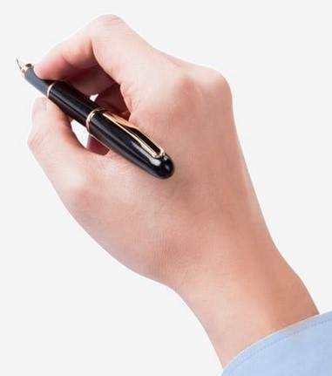
Hello Visitors!
Help us to get to know
you by putting ALL
your contact info on
the attendance sheet.

Slide 3



SERVING TODAY
Hosts: Herringtons
Liturgist: Trish Reisener
Pianist: Kathy Dawson
Treats: Apples
TV Screens: CJ Albertson

Slide 4


Today’s
VIDEO PRELUDE:
Mercy Said No
Mercy Said No

Slide 5



Today’s
HYMNS
#707 & #2160

Slide 6

Thank you…
to everyone who sponsored a lily for the altar.
You may take yours home today, please.

Slide 7

It’s Here!
EUMC Annual
RUMMAGE SALE
Apr 23-25
Apr 23-25

Slide 8

To assist with the Rummage Sale
U.W.F. has moved its meeting . . .
U.W.F.
. . .to the following Wednesday:
April 29 @ 3pm

Slide 9


CREW for Apr. 26th
CREW for Apr. 26th
Hosts: Kelly Cronkleton & Betty Frazee
Organist: Tom Luther
Liturgist: Keith Riewerts
TV Screens: CJ Albertson
Treats: Sue Cannon
Flowers: * Lilies *

Slide 10
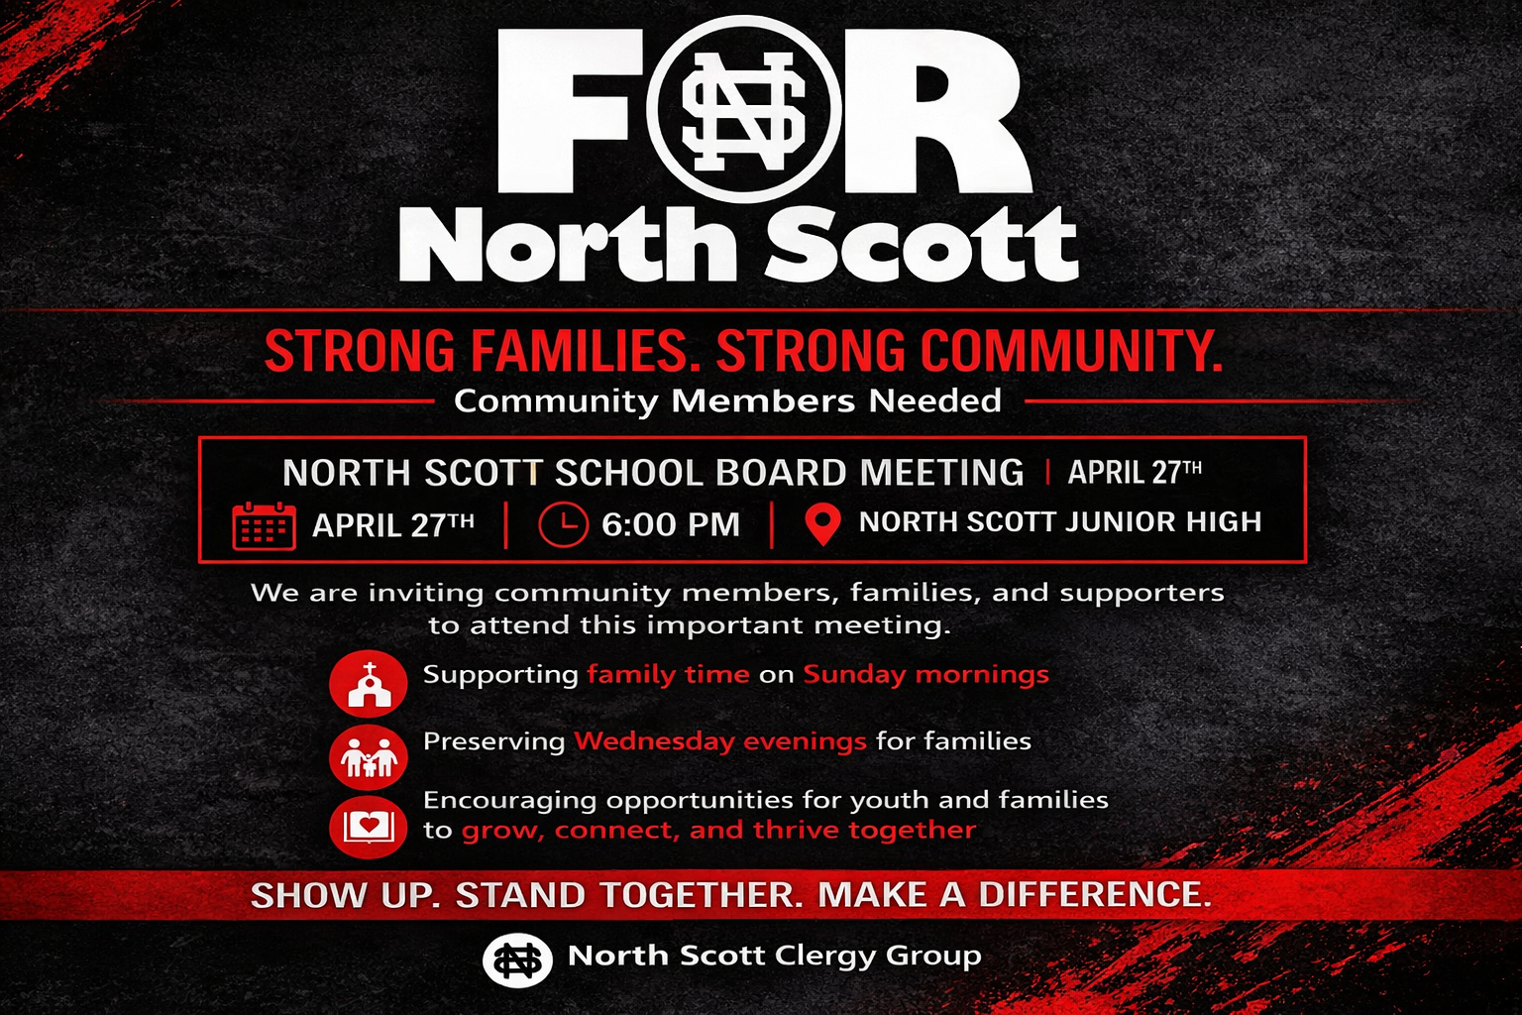

Slide 11

Wednesday, Apr 29th
Wednesday, Apr 29th
Pastor & CJ will be leading worship at
Grand Haven
Office will be closed 9:45-11am
Office will be closed 9:45-11am

Slide 12


“The MISSION of the
Eldridge United Methodist Church
is to be a community of loving disciples who proclaim and live love of God and neighbor.”

Slide 13

APRIL at the
FOOD PANTRY
Cleaning
Supplies

Slide 14

Women of the Bible
Quilting Bible Study
Mondays @ 10am

Slide 15

Join us for
TUESDAY
BIBLE STUDY
10 am

Slide 16

YOGA time!
YOGA time!
Come join us
Wednesday mornings
9am in the sanctuary

Slide 17

Join us!
@ Tasty Café
2nd
Saturdays
@ 7am

Slide 18


The “Odd-Squad” presents….
The “Odd-Squad” presents….
After-Church PARTY – May 3rd
Mark your calendar – Ole!

Slide 19


Easter Baskets!
Raised $700 + sent 10 BASKETS
to Pediatric Ward!

Slide 20

ALTAR FLOWERS
ALTAR FLOWERS
Sign-Up Sheets
on the
Gathering Area Window

Slide 21



Help? Sign-Up in G.A.
to all who helped!!!

Slide 22

Not feeling well? Out of town?
No matter the reason, we miss you when you aren’t in church.
However, you don’t need to miss church . . .
Sunday Worship is always recorded and available
in its entirety on our
Website or FaceBook page
by Monday morning.

Slide 23



www.eldridgeumc.org

