Slide 1


Slide 2
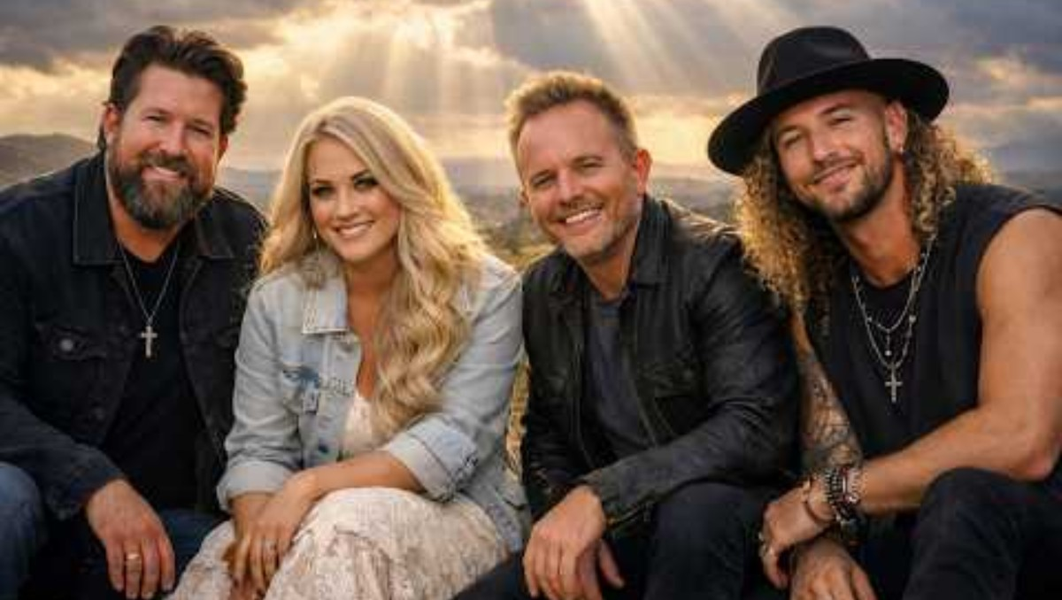

Slide 3


Slide 4


Prelude
“My Lord, What a Morning”
Kathy Dawson, piano

Slide 5
CALL to
WORSHIP
(Read Responsively)

Slide 6
LITURGIST:
When the winds rise
and the waves threaten,
Christ still comes
toward us.

Slide 7
PEOPLE:
We look for him – even in the dark – and we listen for his voice saying, “Take heart;
it is I. Do not be afraid.”

Slide 8
LITURGIST:
Like Peter,
we are bold one moment
and uncertain the next.

Slide 9
PEOPLE:
Yet even our doubt can
become a doorway to
deeper trust when we call out, “Lord, save me!”

Slide 10
LITURGIST:
Jesus does not wait
for perfect faith;
He reaches out his hand.

Slide 11
PEOPLE:
We come to worship the One who meets us on the water
& brings us safely to himself.

Slide 12
LITURGIST:
Come, then –
bring your faith.
Bring your questions.

Slide 13
PEOPLE:
We will fix our eyes on Jesus, as we worship him together.
Amen.

Slide 14

HYMN #707
“Hymn of Promise”

Slide 15
Verse 1:
In the bulb there is a flower,
in the seed, an apple tree;
in cocoons, a hidden promise:
butterflies will soon be free!

Slide 16
In the cold and snow of winter
there’s a spring that waits to be,
unrevealed until its season,
something God alone can see.

Slide 17
Verse 2:
There’s a song in every silence,
seeking word and melody;
There’s a dawn in every darkness,
bringing hope to you and me.

Slide 18
From the past will come the future;
what it holds, a mystery,
unrevealed until its season,
something God alone can see.

Slide 19
Verse 3:
In our end is our beginning;
in our time, in-fin-i-ty;
in our DOUBT there is believing;
in our life, e-ter-ni-ty.

Slide 20
In our death, a res-ur-rec-tion;’
at the last, a vic-to-ry,
unrevealed until its season,
something God alone can see.

Slide 21

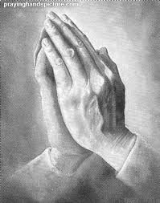
Opening
Prayer

Slide 22
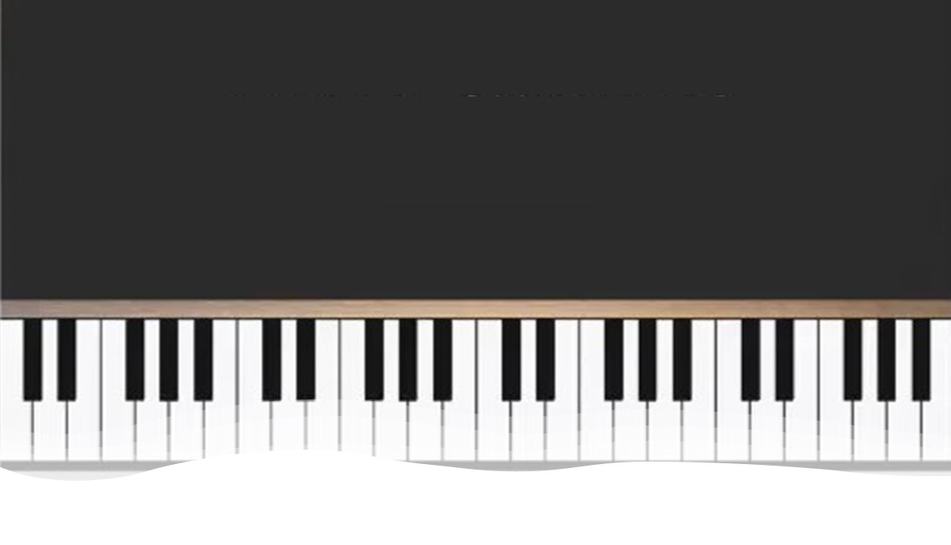
“It Is Well With
My Soul”
Kathy Dawson & CJ Albertson

Slide 23

^Gospel Reading
Matthew 14:22-33

Slide 24
Immediately he made the disciples get into the boat and go before him to the other side, while he dismissed the crowds.
And after he had dismissed the crowds, he went up on the mountain by himself to pray.

Slide 25
When evening came, he was there alone, but the boat by this time was a long way from the land, beaten by the waves, for the wind was against them.
And in the 4th watch of the night he came to them, walking on the sea.

Slide 26
But when the disciples saw him walking on the sea, they were terrified, and said, “It is a ghost!” and they cried out in fear.
But immediately Jesus spoke to them, saying, “Take heart; it is I. Do not be afraid.”

Slide 27
And Peter answered him, “Lord, if it is you, command me to come to you on the water.”
He said, “Come.”

Slide 28
So Peter got out of the boat and walked on the water and came to Jesus.
But when he saw the wind, he was afraid, and beginning to sink he cried out, “Lord, save me.”

Slide 29
Jesus immediately reached out his hand and took hold of him, saying to him, “O you of little faith, why did you doubt?” And when they got into the boat, the wind ceased. And those in the boat worshiped him, saying,
“Truly you are the Son of God.”

Slide 30
LITURGIST:
This is the word of God for the people of God.
PEOPLE:
Thanks be to God!

Slide 31
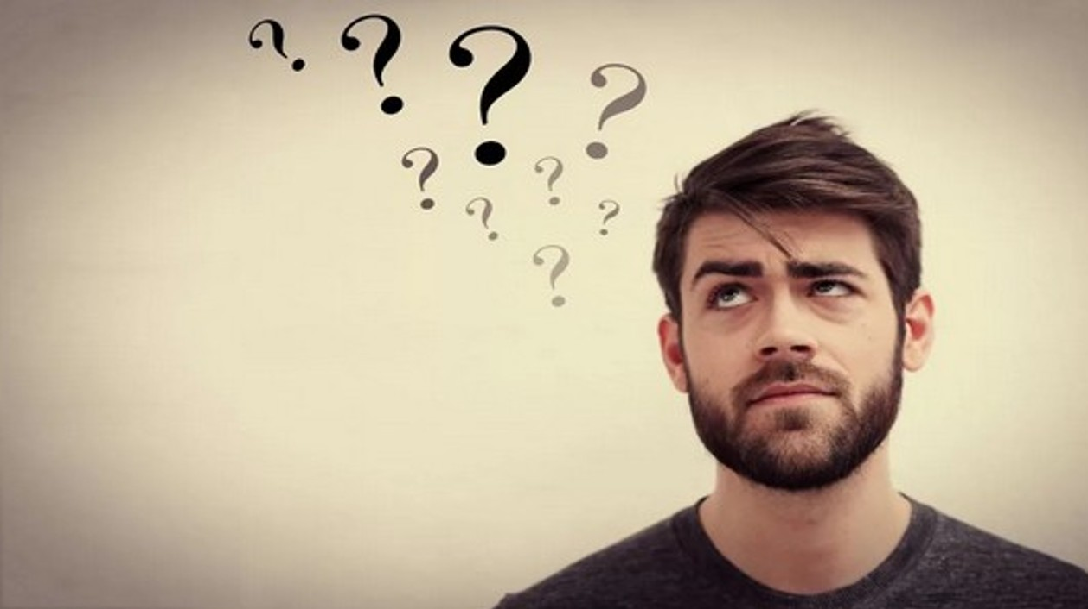
God
Can Handle Your Doubts

Slide 32
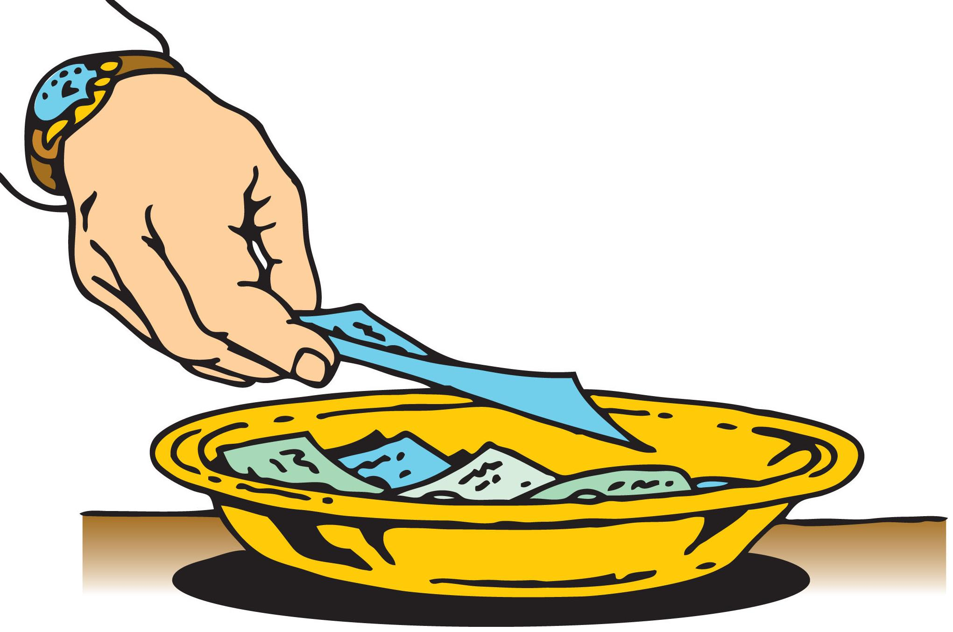


As the music plays, TITHES & GIFTS
may be placed in the offering plates
located at the front or the rear
of the sanctuary.
Thank you!

Slide 33
Offertory
“We Are The Church”

Slide 34


Please Stand
the
Doxology

Slide 35
Praise God,
from whom
all blessings flow;

Slide 36
Praise God,
all creatures here below.

Slide 37
Alleluia!
Alleluia!

Slide 38
Praise God,
the source of
all our gifts!

Slide 39
Praise Jesus Christ
whose power
uplifts!

Slide 40
Praise the Spirit,
Holy Spirit!

Slide 41
Alleluia!
Alleluia!
Alleluia!

Slide 42



SHARING
Pastoral
Prayer
JOYS
& CONCERNS

Slide 43
in unison:
Our Father,
who art in heaven,
hallowed be thy name.

Slide 44
Thy kingdom come,
thy will be done
on earth
as it is in heaven.

Slide 45
Give us this day
our daily bread

Slide 46
and forgive us our trespasses,
as we forgive those who trespass against us.

Slide 47
And lead us
not into temptation,
but deliver us
from evil.

Slide 48
For thine is the kingdom,
and the power,
and the glory forever. Amen.

Slide 49
HYMN #2160 (tfws)
“Into My Heart

Slide 50
Verse 1:
Into my heart, into my heart,
come into my heart, Lord Jesus;
Come in today, come in to stay;
Come into my heart, Lord Jesus!

Slide 51
Verse 2:
Out of my heart, out of my heart,
shine out of my heart, Lord Jesus;
Shine out today, shine out alway;
Shine out of my heart, Lord Jesus.

Slide 52
Blessing &
Dismissal

Slide 53
Postlude
“How Firm a Foundation”

